Slide 1
Communications:
Final Project
CS 401
Group 7

Slide 2
Meet the Team
(for the last time!)
Victor
Clarize
Darien
CS Major
Focus: Client
CS Major
Focus: Server
CS Major
Focus: Networking

Slide 3

Agenda
1. Review Requirements
2. Preview Application
3. Live Demo

Slide 4
Our Two Most Fundamental Requirements
The service provided by our application is text-based, both synchronous and asynchronous.
The service provided by our application supports network based, group, and scalable communication.
Setting the broad baseline for the application.
Establishing a primary constraint regarding functionality.
Dictating how the communication application should operate.
Defining a clear purpose for the service.

Slide 5
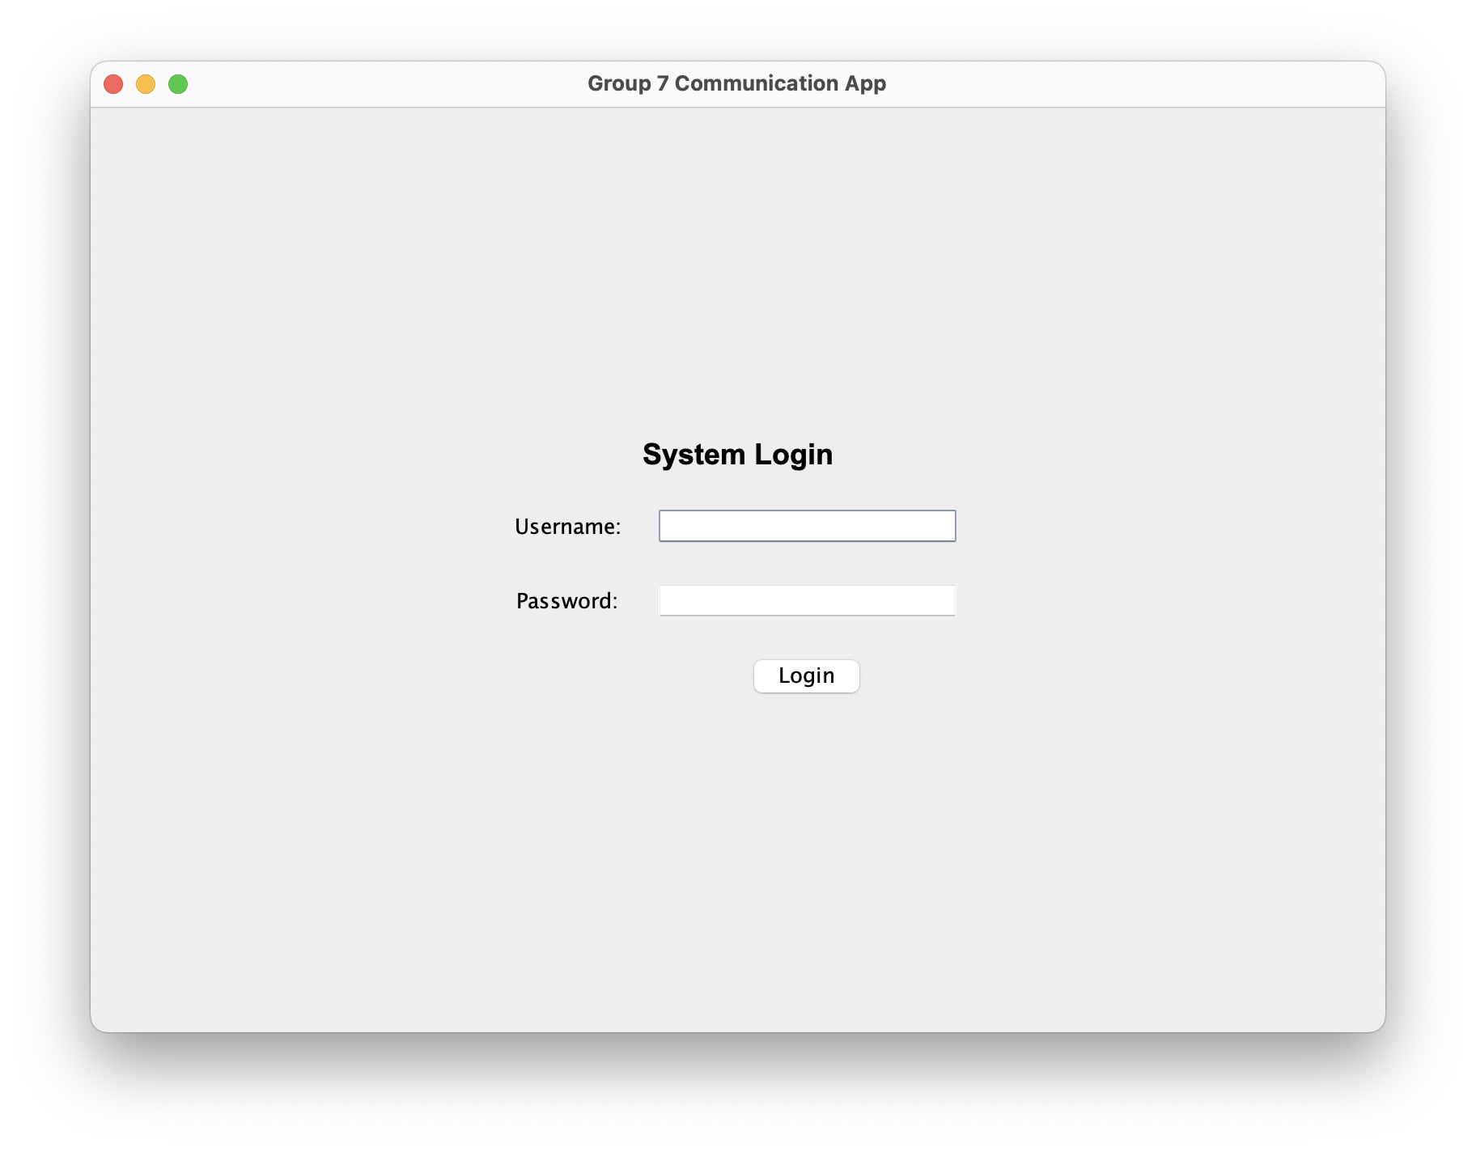
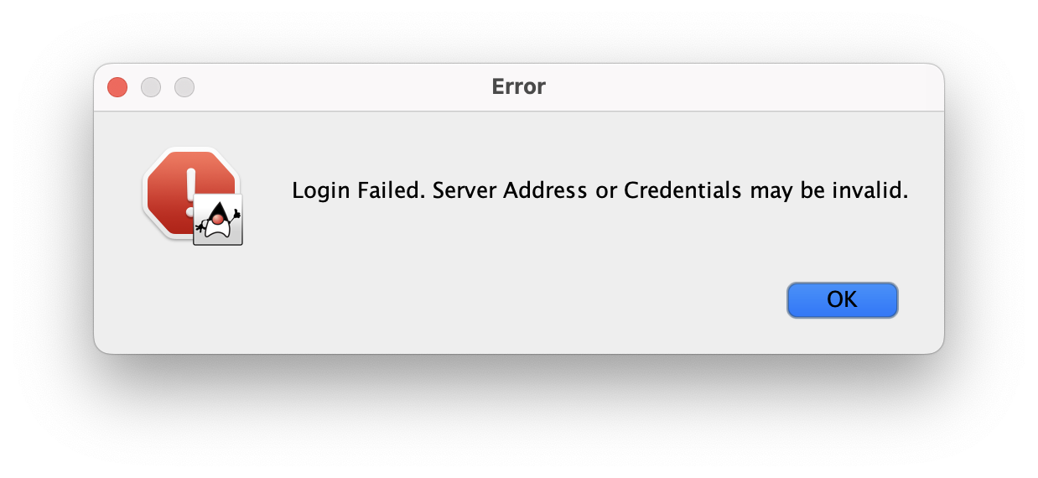
User Requirements & Features
The login interface must take input for a unique username and password.
  The interface must validate completion, verify authentication, and display a success or failure response.
  Messaging features are only accessible upon success.

Slide 6
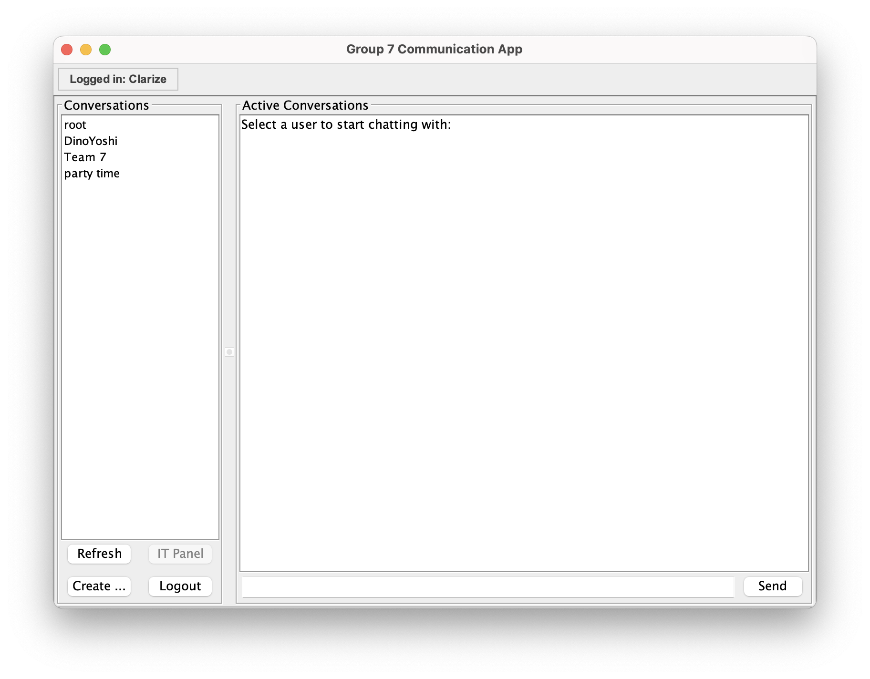
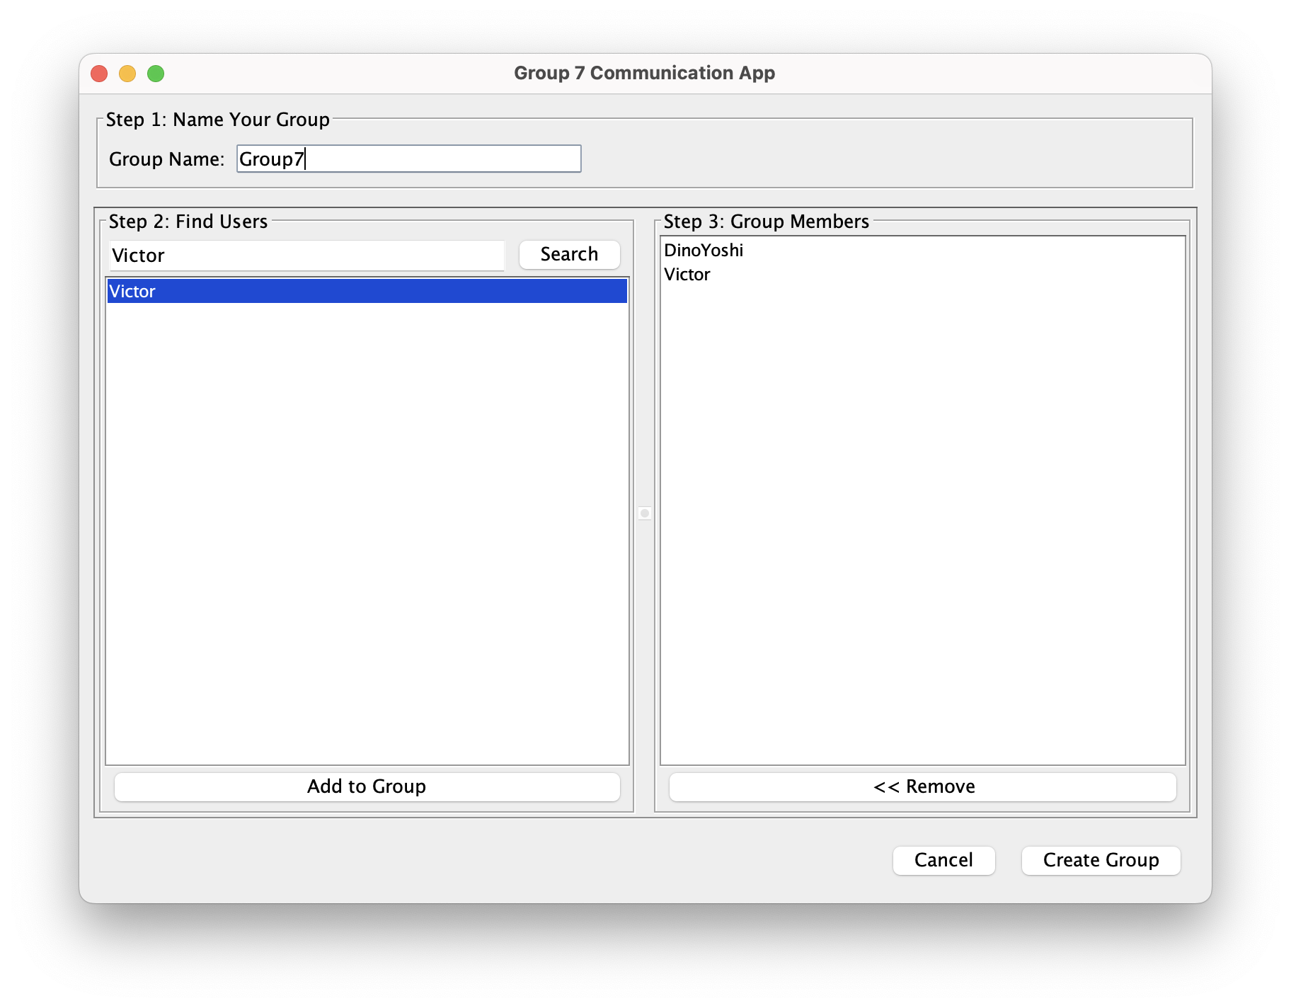
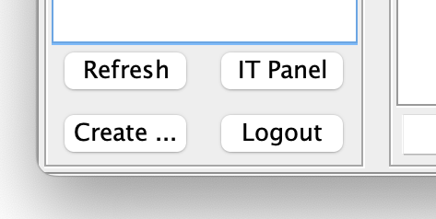
Users will be able to search for other users to either chat individually with or form a group with.
Users can view and access their chronological (scrollable) chat history.
No user, including IT, will have the ability to update or delete any stored messages.
The messaging interface must display a text input field for sending messages including a send action and a messaging panel of users and existing chats.
The system must ensure that all logs and chat history is not accessible to non-IT users.

Slide 7
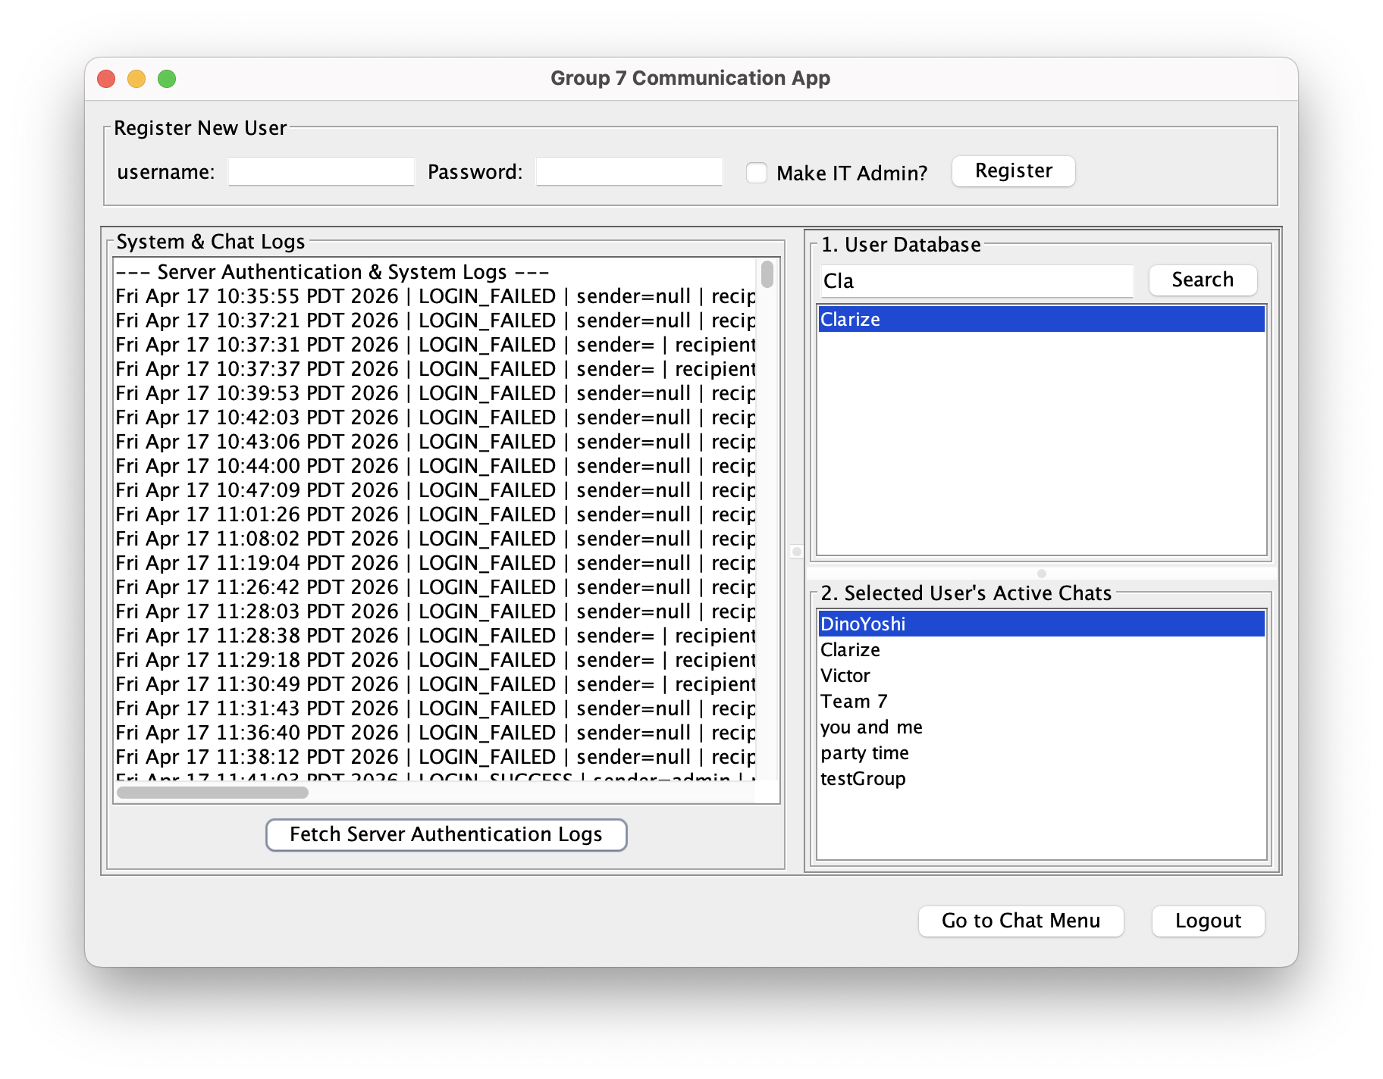
IT Requirements & Features
The system must provide an administrative interface for IT users.
  This must allow IT users to register new users with a unique username and password, creating and storing a new user record.
The server module must provide IT access to view any user's complete chat log upon request, displaying all messages with timestamps and participant information.

Slide 8
More Significant Requirements
The system must ensure two-way connection, allowing both to send and receive data.
Security-wise, only the most minimum level of security will be provided for the application.
The server must maintains persistent data that stores all registered usernames, password, and roles (admin, IT, etc.).
The server must log all login attempts, with timestamps and usernames.
The server must permanently store every text message by appending user specific log files.
No user, including IT, will have the ability to update or delete any stored messages.
All communication must follow a protocol consisting of a message identifier, a sender and recipient identifier, and timestamp.
The system must support strictly text-based communication and reject any attempt otherwise.

Slide 9
Now for our Demo!

